Slide 1



Atmospheric effects for CMB observations
Church, S. E. (1995). Predicting residual levels of atmospheric sky noise in ground-based observations of the Cosmic Background Radiation. Monthly Notices of the Royal Astronomical Society, 272(3), 551-569
Stefano Mandelli – 2° year PhD Student.
20 / 5 / 2020

Slide 2
Who am I
2° year PhD Student
I work with the Instrumental cosmology research group
LiteBIRD: A space satellite for CMB polarization observations.
In-Lab activity: Optic calibration, RF response and spectro-pol angle calibration
Planning the In-Flight calibration: strategies to calibrate the polarization during the in-flight operations.
LSPE/STRIP: A ground-based experiment devoted to observe the CMB polarizations at large scale angles.
Sensitivity simulations
Systematic characterization
Notes:
Prova

Slide 3
Main topics
A brief introduction about the CMB origins
The atmosphere as a dispersion medium
Characterization of the atmosphere’s turbulent structures by direct measurements
Atmospheric fluctuations effects on CMB observations
Conclusion: Questions and discussion

Slide 4
The Cosmic Microwave Background Radiation (CMB-R)
Is a relic radiation from the early stage of our Universe
This radiation coupled with the primordial hot baryonic plasma for the first ~380,000 years of the universe evolution.
When the plasma temperature fell below ~3,000 K matter became neutral and radiation decoupled, propagating freely in the expanding universe.
Today we can detect this radiation as a black-body emission at ~2.73 K, with a spectrum peak in the microwaves, and its photons are linear polarized

Slide 5
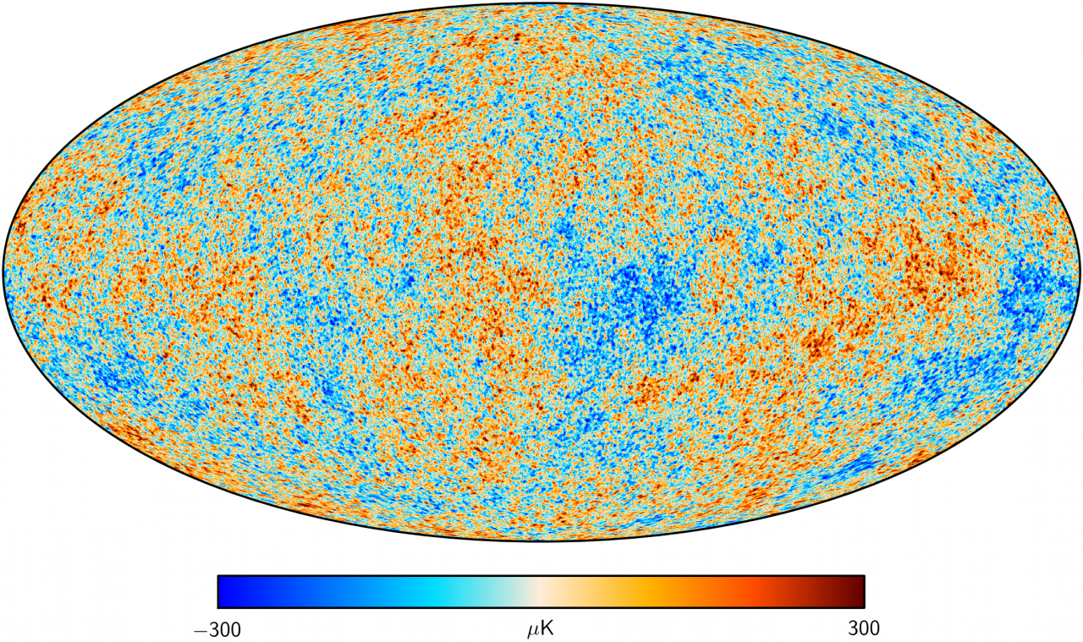
Cosmic Microwave Background anisotropies
Intensity anisotropies
Polarization anisotropies
Planck 2018 data release

Slide 6
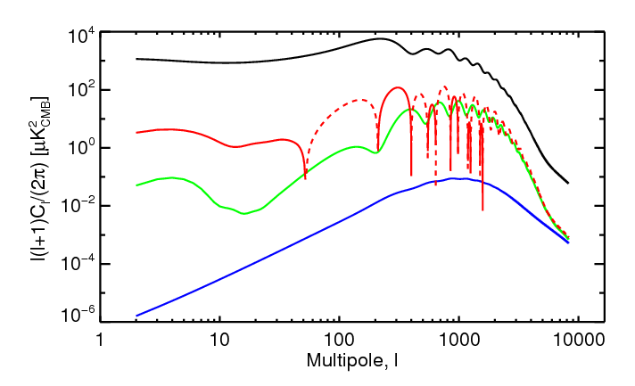
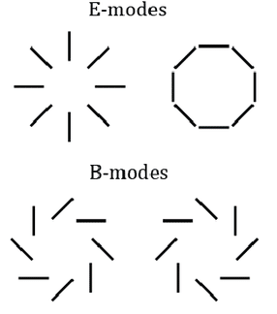
Angular power spectrum
TT
TE
EE
BB
We use the two-point angular correlation function method to unhide the cosmological information that it is coded into the maps (both in polarization and temperature)

Slide 7
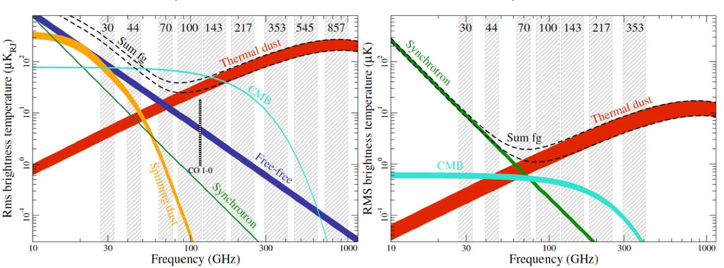
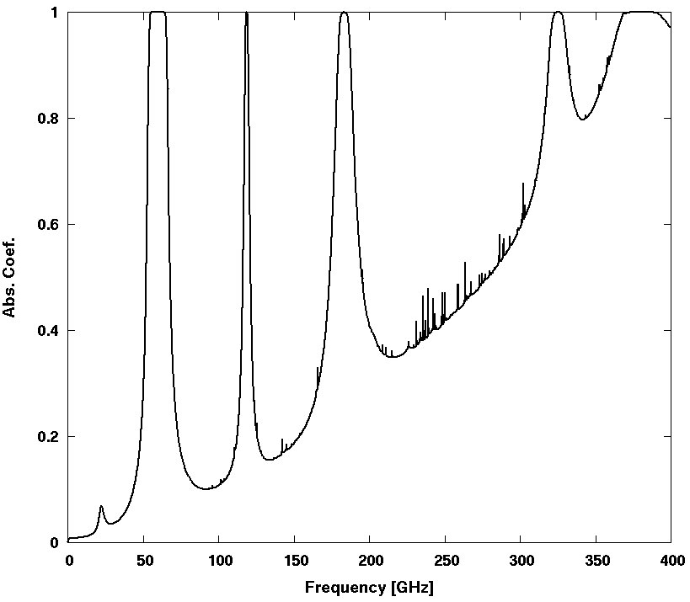
The foregrounds cleaning
Galactic foregrounds
Polarized and un-polarized contribute
For this reason, is vital to ensure a good frequency coverage order to get rid of them.
No fluctuations in time
Atmospheric emission
Mostly un-polarized (I → Q; I → U leakage)
It depends on site location, and weather condictions
Time fluctuations driven by atmosphere evolution

Slide 8
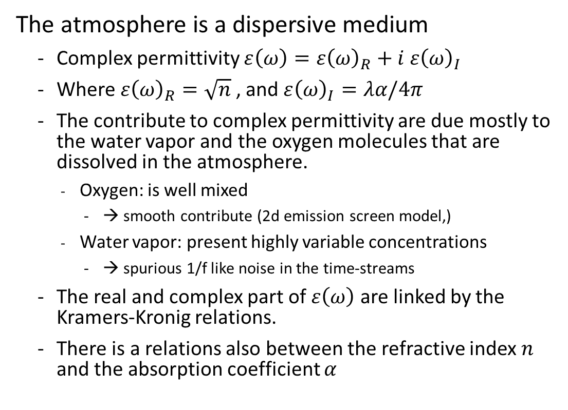
Atmospheric dispersion model
H20
O2
O2
H2O
H2O
The atmosphere is a dispersive medium
Complex permittivity $ε\left(ω\right)=ε{\left(ω\right)}_{R}+i ε{\left(ω\right)}_{I}$
Where $ε{\left(ω\right)}_{R}=\sqrt{n}$ , and $ε{\left(ω\right)}_{I}=λα/4π$
The contribute to complex permittivity are due mostly to the water vapor and the oxygen molecules that are dissolved in the atmosphere.
Oxygen: is well mixed
→ smooth contribute (2d emission screen model,)
Water vapor: present highly variable concentrations
→ spurious 1/f like noise in the time-streams
The real and complex part of $ε\left(ω\right)$ are linked by the Kramers-Kronig relations.
There is a relations also between the refractive index $n$ and the absorption coefficient $α$
Frequency range for balloon and space satellites observations

Slide 9
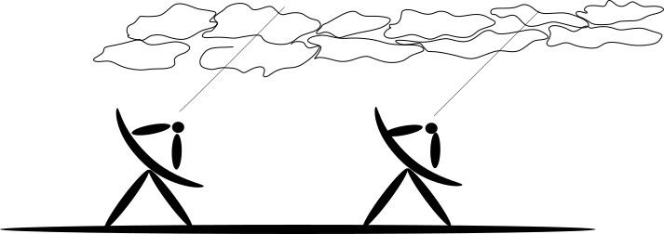
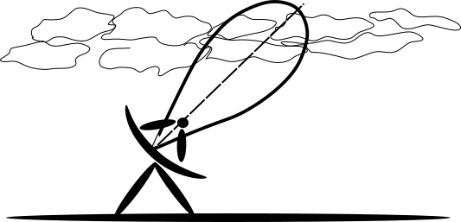
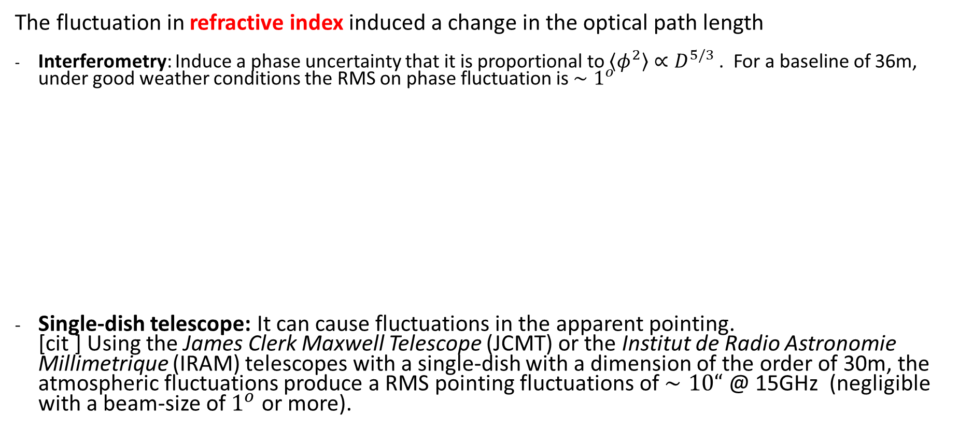
Atmospheric dispersion model – refractive index
The fluctuation in refractive index induced a change in the optical path length
Interferometry: Induce a phase uncertainty that it is proportional to $〈φ^{2}〉∝D^{5/3}$ . For a baseline of 36m, under good weather conditions the RMS on phase fluctuation is $∼1^{o}$
Single-dish telescope: It can cause fluctuations in the apparent pointing. [cit ] Using the James Clerk Maxwell Telescope (JCMT) or the Institut de Radio Astronomie Millimetrique (IRAM) telescopes with a single-dish with a dimension of the order of 30m, the atmospheric fluctuations produce a RMS pointing fluctuations of $∼10“$ @ 15GHz (negligible with a beam-size of $1^{o}$ or more).
D

Slide 10
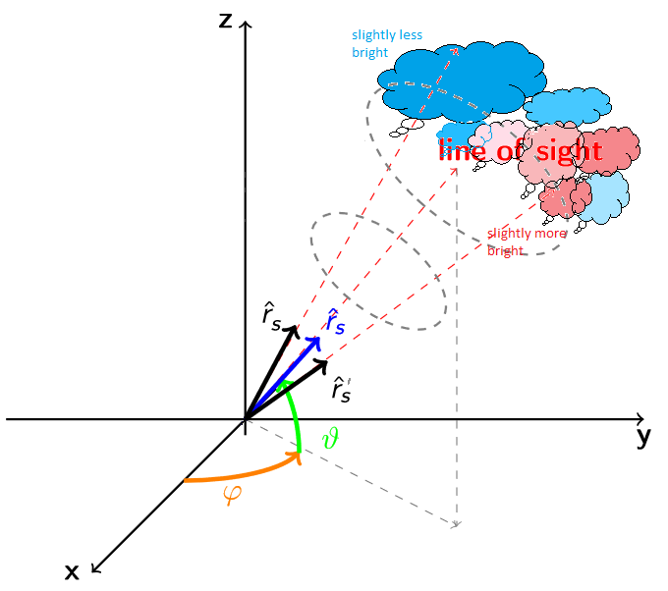
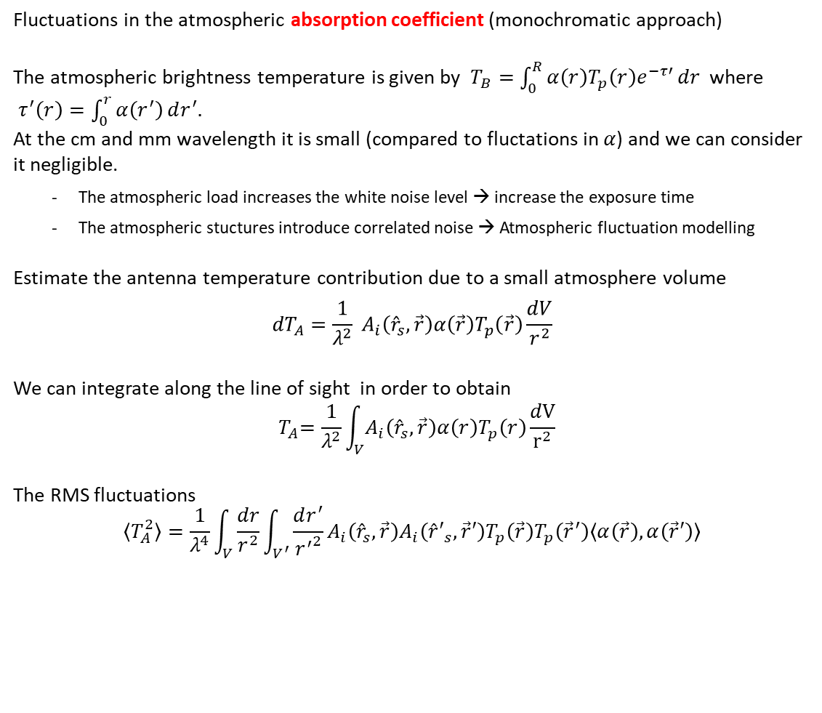
Atmospheric dispersion model – absorption coefficient
Fluctuations in the atmospheric absorption coefficient (monochromatic approach)
The atmospheric brightness temperature is given by $T_{B}=\int_{0}^{R}{α\left(r\right)T_{p}\left(r\right)e^{−τ′}}dr$ where $τ^{′}\left(r\right)=\int_{0}^{r}{α\left(r^{′}\right)}dr^{′}.$ At the cm and mm wavelength it is small (compared to fluctations in $α$) and we can consider it negligible.
The atmospheric load increases the white noise level → increase the exposure time
The atmospheric stuctures introduce correlated noise → Atmospheric fluctuation modelling
Estimate the antenna temperature contribution due to a small atmosphere volume
$${dT}_{A}=\frac{1}{λ^{2}} A_{i}\left({\hat{r}}_{s}, \vec{r}\right)α\left(\vec{r}\right)T_{p}\left(\vec{r}\right)\frac{dV}{r^{2}}$$
We can integrate along the line of sight in order to obtain $${ T}_{A}=\frac{1}{λ^{2}}\int_{V}{A_{i}\left({\hat{r}}_{s}, \vec{r}\right)α\left(r\right)T_{p}\left(r\right)}\frac{dV}{r^{2}}$$
The RMS fluctuations
$$〈T_{A}^{2}〉=\frac{1}{λ^{4}}\int_{V}{\frac{dr}{r^{2}}}\int_{V^{′}}{\frac{dr^{′}}{{r^{′}}^{2}}}A_{i}\left({\hat{r}}_{s}, \vec{r}\right)A_{i}\left({\hat{r}′}_{s}, \vec{r}′\right)T_{p}\left(\vec{r}\right)T_{p}\left({\vec{r}}^{′}\right)〈α\left(\vec{r}\right),α\left(\vec{r}′\right)〉$$

Slide 11
Atmospheric dispersion model – absorption coefficient
Fluctuations in the atmospheric absorption coefficient (monochromatic approach)
The atmospheric brightness temperature is given by $T_{B}=\int_{0}^{R}{α\left(r\right)T_{p}\left(r\right)e^{−τ′}}dr$ where $τ^{′}\left(r\right)=\int_{0}^{r}{α\left(r^{′}\right)}dr^{′}.$ At the cm and mm wavelength it is small (compared to fluctations in $α$) and we can consider it negligible.
The atmospheric load increases the white noise level → increase the exposure time
The atmospheric stuctures introduce correlated noise → Atmospheric fluctuation modelling
Estimate the antenna temperature contribution due to a small atmosphere volume
$${dT}_{A}=\frac{1}{λ^{2}} A_{i}\left({\hat{r}}_{s}, \vec{r}\right)α\left(\vec{r}\right)T_{p}\left(\vec{r}\right)\frac{dV}{r^{2}}$$
We can integrate along the line of sight in order to obtain $${ T}_{A}=\frac{1}{λ^{2}}\int_{V}{A_{i}\left({\hat{r}}_{s}, \vec{r}\right)α\left(r\right)T_{p}\left(r\right)}\frac{dV}{r^{2}}$$
The RMS fluctuations
$$〈T_{A}^{2}〉=\frac{1}{λ^{4}}\int_{V}{\frac{dr}{r^{2}}}\int_{V^{′}}{\frac{dr^{′}}{{r^{′}}^{2}}}A_{i}\left({\hat{r}}_{s}, \vec{r}\right)A_{i}\left({\hat{r}′}_{s}, \vec{r}′\right)T_{p}\left(\vec{r}\right)T_{p}\left({\vec{r}}^{′}\right)〈α\left(\vec{r}\right),α\left(\vec{r}′\right)〉$$
?

Slide 12
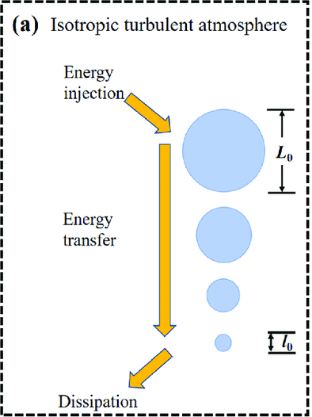
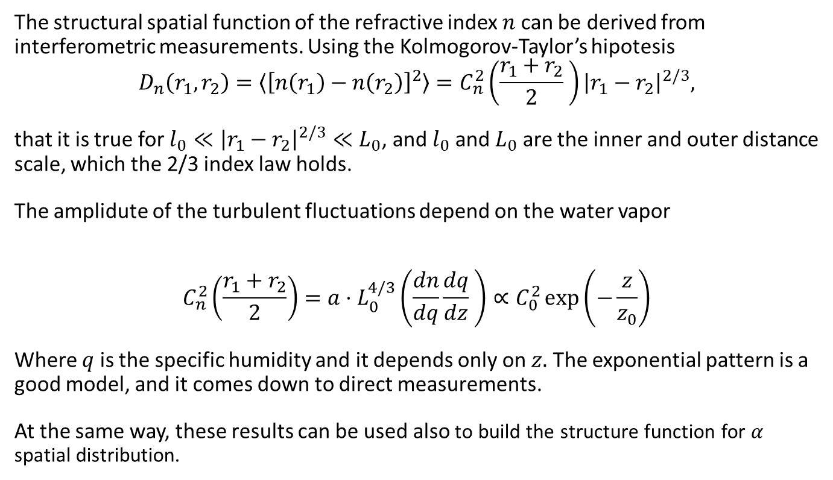
Characterizing the turbulent structure of the atmosphere
The structural spatial function of the refractive index $n$ can be derived from interferometric measurements. Using the Kolmogorov-Taylor’s hipotesis
$$D_{n}\left(r_{1},r_{2}\right)=〈{\left[n\left(r_{1}\right)−n\left(r_{2}\right)\right]}^{2}〉=C_{n}^{2}\left(\frac{{r_{1}+r}_{2}}{2} \right){\left|r_{1}−r_{2}\right|}^{2/3},$$
that it is true for $l_{0}≪{\left|r_{1}−r_{2}\right|}^{2/3}≪L_{0}$, and $l_{0}$ and $L_{0}$ are the inner and outer distance scale, which the 2/3 index law holds.
The amplidute of the turbulent fluctuations depend on the water vapor
$$C_{n}^{2}\left(\frac{{r_{1}+r}_{2}}{2}\right)=a⋅L_{0}^{4/3}\left(\frac{dn}{dq}\frac{dq}{dz} \right)∝C_{0}^{2}\exp\left(−\frac{z}{z_{0}}\right)$$
Where $q$ is the specific humidity and it depends only on $z.$ The exponential pattern is a good model, and it comes down to direct measurements.
At the same way, these results can be used also to build the structure function for $α$ spatial distribution.

Slide 13
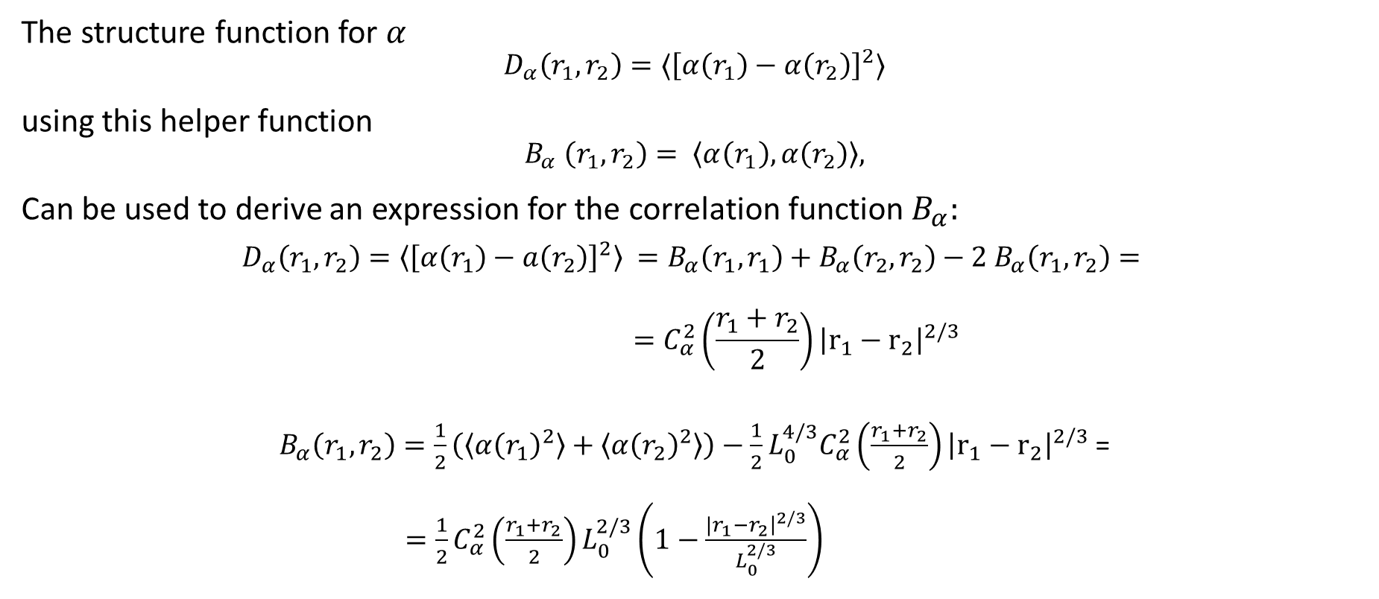
The spatial correlation function for the absorption coefficient
The structure function for $α$
$$D_{α}\left(r_{1},r_{2}\right)=〈{\left[α\left(r_{1}\right)−α\left(r_{2}\right)\right]}^{2}〉$$
using this helper function
$$B_{α} \left(r_{1},r_{2}\right)= 〈α\left(r_{1}\right), α\left(r_{2}\right)〉,$$
Can be used to derive an expression for the correlation function $B_{α}:$
$$D_{α}\left(r_{1},r_{2}\right)=〈{\left[α\left(r_{1}\right)−a\left(r_{2}\right)\right]}^{2}〉 =B_{α}\left(r_{1},r_{1}\right)+B_{α}\left(r_{2},r_{2}\right)−2 B_{α}\left(r_{1},r_{2}\right)= \\ =C_{α}^{2}\left(\frac{r_{1}+r_{2}}{2}\right){\left|r_{1}−r_{2}\right|}^{2/3}$$
$B_{α}\left(r_{1},r_{2}\right)=\frac{1}{2}\left(〈α{\left(r_{1}\right)}^{2}〉+〈α{\left(r_{2}\right)}^{2}〉\right)−\frac{1}{2}L_{0}^{4/3}C_{α}^{2}\left(\frac{r_{1}+r_{2}}{2}\right){\left|r_{1}−r_{2}\right|}^{2/3}$ = $=\frac{1}{2}C_{α}^{2}\left(\frac{r_{1}+r_{2}}{2}\right)L_{0}^{2/3}\left(1−\frac{{|r}_{1}−r_{2}{\left.​\right|}^{2/3}}{L_{0}^{2/3}}\right)$

Slide 14
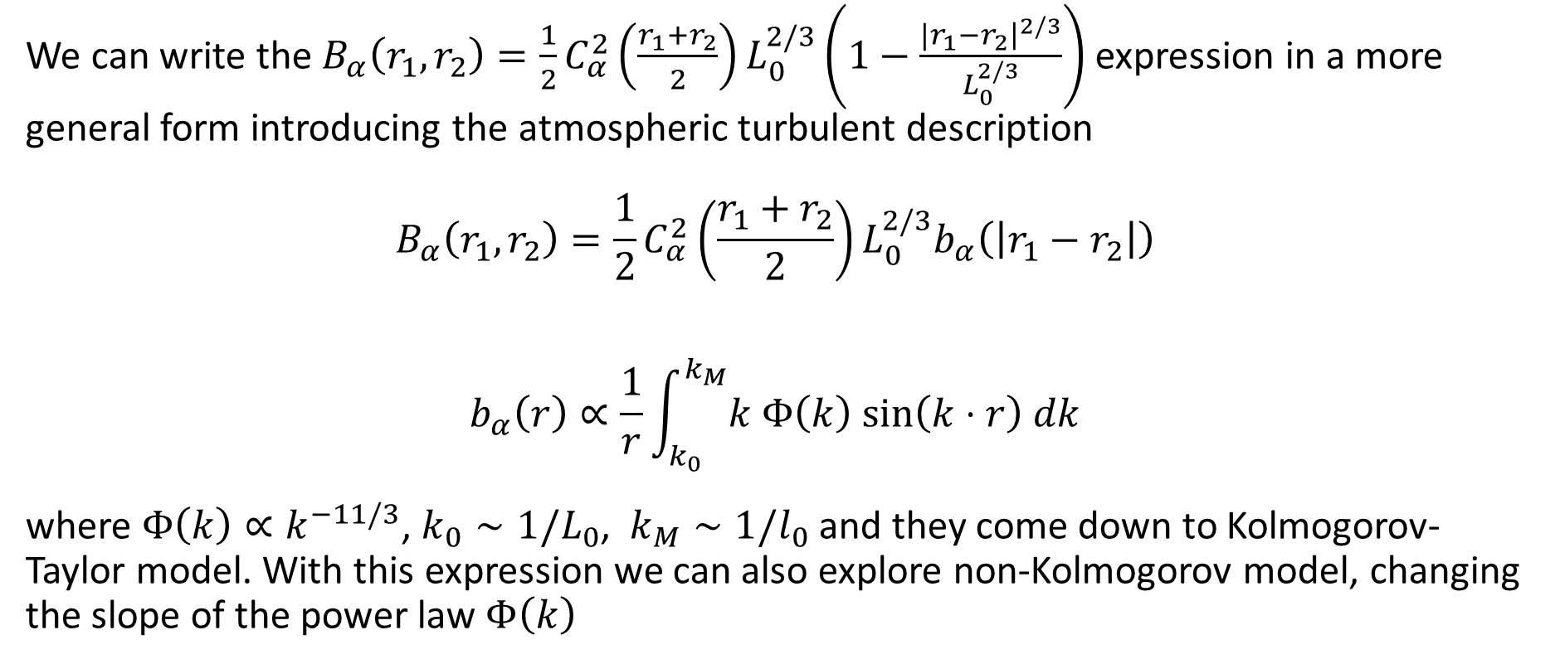
The spatial correlation function for the absorption coefficient
We can write the $B_{α}\left(r_{1},r_{2}\right)=\frac{1}{2}C_{α}^{2}\left(\frac{r_{1}+r_{2}}{2}\right)L_{0}^{2/3}\left(1−\frac{{|r}_{1}−r_{2}{\left.​\right|}^{2/3}}{L_{0}^{2/3}}\right)$ expression in a more general form introducing the atmospheric turbulent description
$$B_{α}\left(r_{1},r_{2}\right)=\frac{1}{2}C_{α}^{2}\left(\frac{r_{1}+r_{2}}{2}\right)L_{0}^{2/3}b_{α}\left(\left|r_{1}−r_{2}\right|\right)$$
$$b_{α}\left(r\right)∝\frac{1}{r}\int_{k_{0}}^{k_{M}}{k Φ\left(k\right) sin\left(k⋅r\right) dk}$$
where $Φ\left(k\right)∝k^{−11/3}$, $k_{0}∼1/L_{0}$, $k_{M}∼1/l_{0}$ and they come down to Kolmogorov-Taylor model. With this expression we can also explore non-Kolmogorov model, changing the slope of the power law $Φ\left(k\right)$

Slide 15
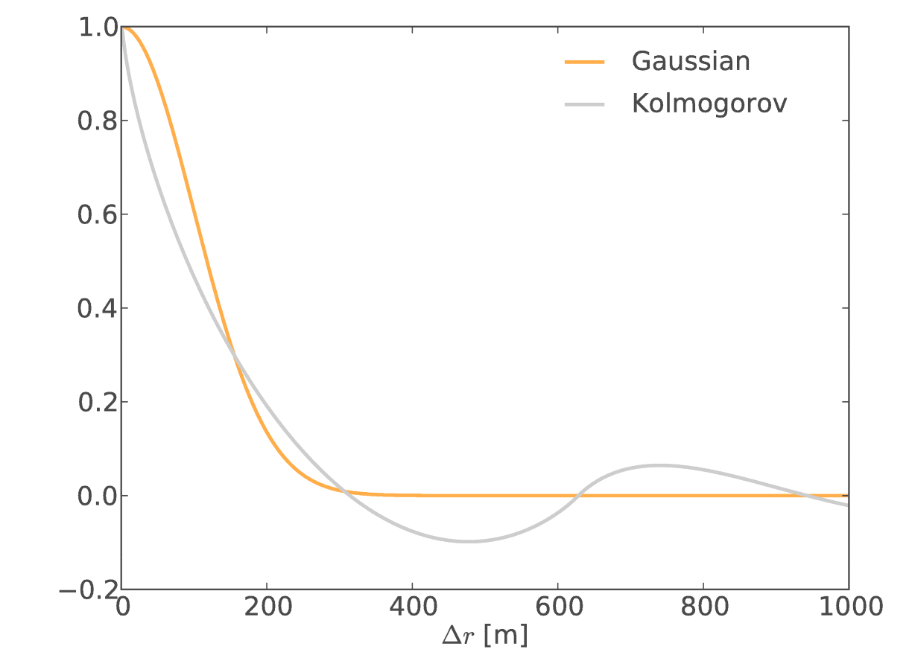
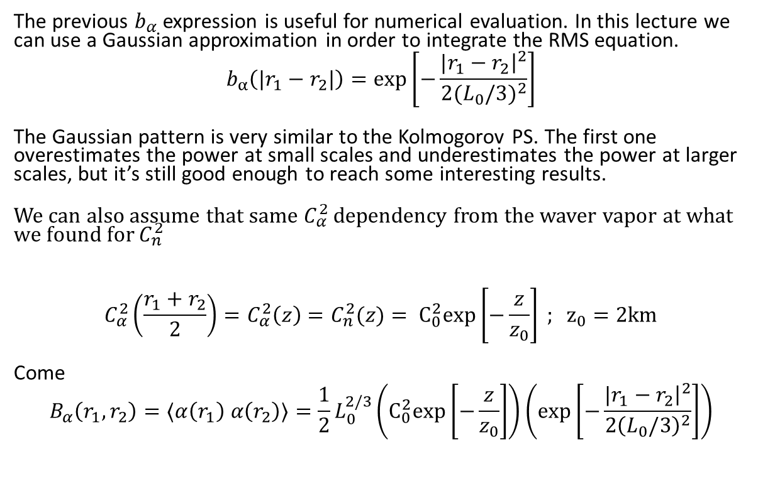
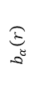
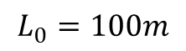
The spatial correlation function for the absorption coefficient
The previous $b_{α}$ expression is useful for numerical evaluation. In this lecture we can use a Gaussian approximation in order to integrate the RMS equation.
$$b_{α}\left({|r}_{1}−r_{2}|\right)=\exp\left[−\frac{{|r}_{1}−r_{2}{\left.​\right|}^{2}}{2{(L_{0}/3)}^{2}}\right]$$
The Gaussian pattern is very similar to the Kolmogorov PS. The first one overestimates the power at small scales and underestimates the power at larger scales, but it’s still good enough to reach some interesting results.
We can also assume that same $C_{α}^{2}$ dependency from the waver vapor at what we found for $C_{n}^{2}$
$$C_{α}^{2}\left(\frac{r_{1}+r_{2}}{2}\right)=C_{α}^{2}\left(z\right)=C_{n}^{2}(z)= C_{0}^{2}exp\left[−\frac{z}{z_{0}}\right] ; z_{0}=2km$$
Come
$$B_{α}\left(r_{1},r_{2}\right)=〈α\left(r_{1}\right) α\left(r_{2}\right)〉=\frac{1}{2}L_{0}^{2/3}\left(C_{0}^{2}exp\left[−\frac{z}{z_{0}}\right]\right)\left(\exp\left[−\frac{{|r}_{1}−r_{2}{\left.​\right|}^{2}}{2{\left(L_{0}/3\right)}^{2}}\right]\right)$$
$$b_{α}\left(r\right)$$
$$L_{0}=100m$$

Slide 16
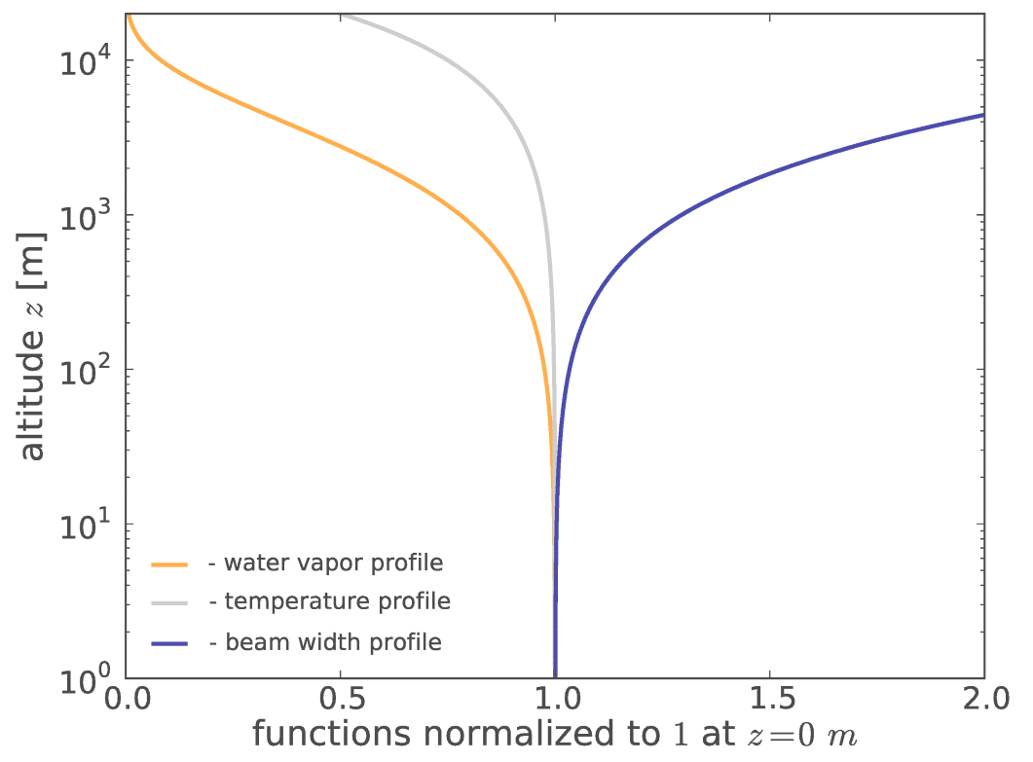
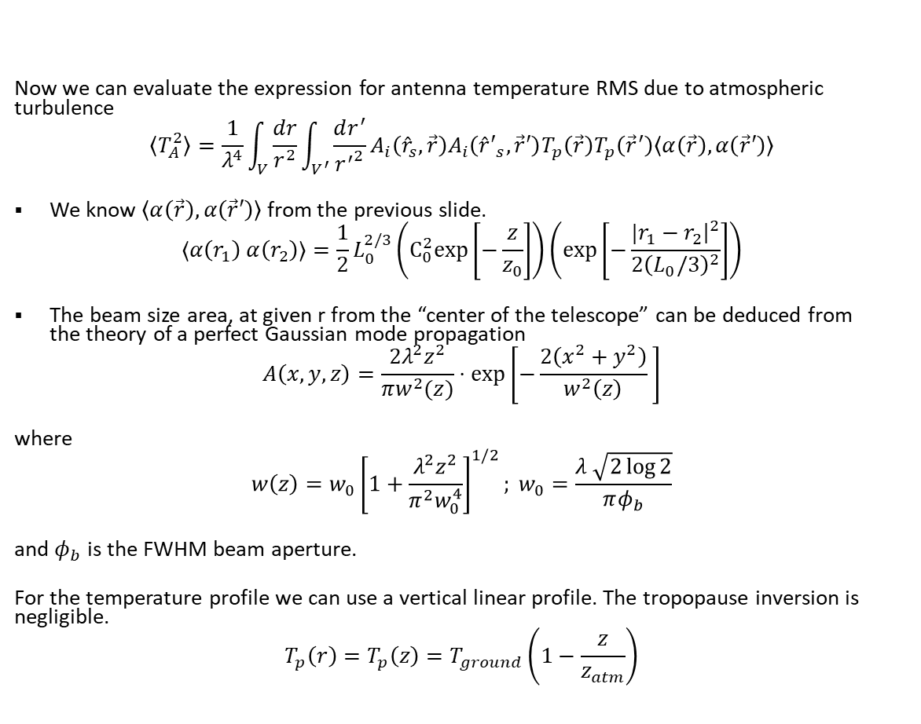
Antenna temperature RMS evaluation
Now we can evaluate the expression for antenna temperature RMS due to atmospheric turbulence
$$〈T_{A}^{2}〉=\frac{1}{λ^{4}}\int_{V}{\frac{dr}{r^{2}}}\int_{V^{′}}{\frac{dr^{′}}{{r^{′}}^{2}}}A_{i}\left({\hat{r}}_{s}, \vec{r}\right)A_{i}\left({\hat{r}′}_{s}, \vec{r}′\right)T_{p}\left(\vec{r}\right)T_{p}\left({\vec{r}}^{′}\right)〈α\left(\vec{r}\right),α\left(\vec{r}′\right)〉$$
We know $〈α\left(\vec{r}\right),α\left(\vec{r}′\right)〉$ from the previous slide.
$$〈α\left(r_{1}\right) α\left(r_{2}\right)〉=\frac{1}{2}L_{0}^{2/3}\left(C_{0}^{2}exp\left[−\frac{z}{z_{0}}\right]\right)\left(\exp\left[−\frac{{|r}_{1}−r_{2}{\left.​\right|}^{2}}{2{\left(L_{0}/3\right)}^{2}}\right]\right)$$
The beam size area, at given r from the “center of the telescope” can be deduced from the theory of a perfect Gaussian mode propagation
$$A\left(x,y,z\right)=\frac{2λ^{2}z^{2}}{πw^{2}(z)}⋅\exp\left[−\frac{2\left(x^{2}+y^{2}\right)}{w^{2}\left(z\right)} \right]$$
where
$$w\left(z\right)=w_{0}{\left[1+\frac{λ^{2}z^{2}}{π^{2}w_{0}^{4}}\right]}^{1/2}; w_{0}=\frac{λ \sqrt{2\log{2}}}{πφ_{b}}$$
and $φ_{b}$ is the FWHM beam aperture.
For the temperature profile we can use a vertical linear profile. The tropopause inversion is negligible.
$$T_{p}\left(r\right)=T_{p}\left(z\right)=T_{ground}\left(1−\frac{z}{z_{atm}}\right)$$

Slide 17
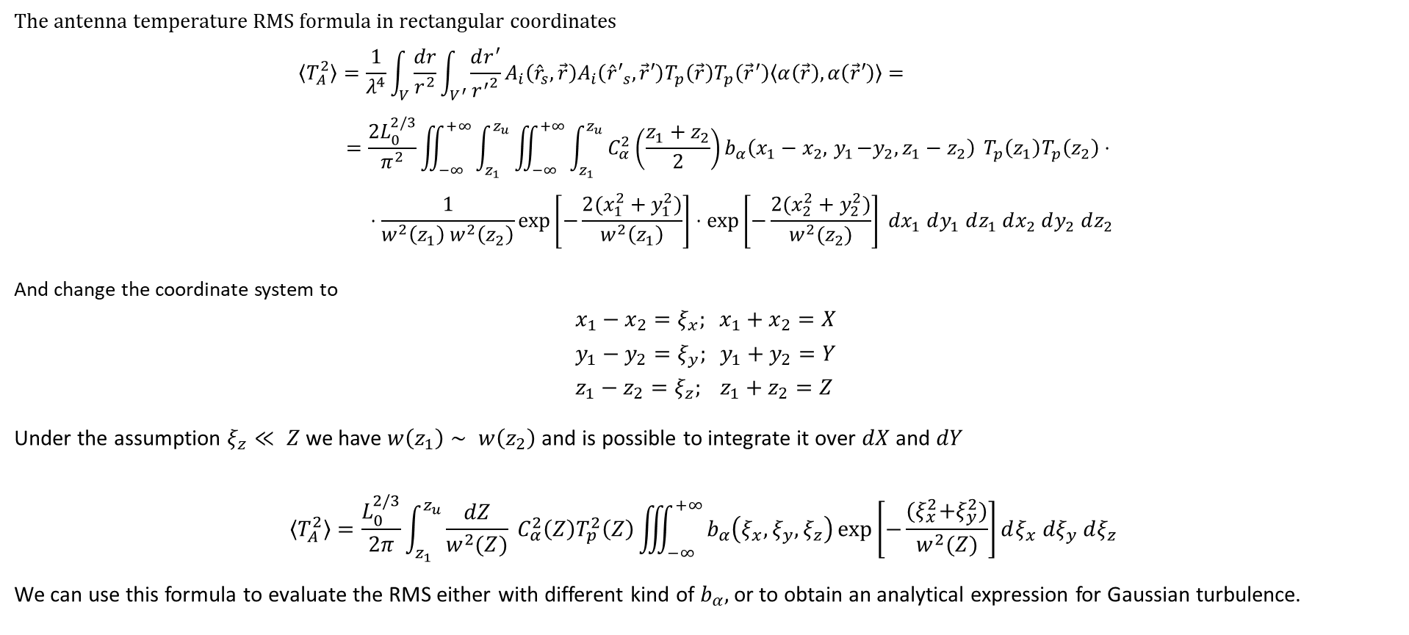
Antenna temperature RMS evaluation
The antenna temperature RMS formula in rectangular coordinates
$$〈T_{A}^{2}〉=\frac{1}{λ^{4}}\int_{V}{\frac{dr}{r^{2}}}\int_{V^{′}}{\frac{dr^{′}}{{r^{′}}^{2}}}A_{i}\left({\hat{r}}_{s}, \vec{r}\right)A_{i}\left({\hat{r}′}_{s}, \vec{r}′\right)T_{p}\left(\vec{r}\right)T_{p}\left({\vec{r}}^{′}\right)〈α\left(\vec{r}\right),α\left(\vec{r}′\right)〉= \\ =\frac{2L_{0}^{2/3}}{π^{2}}\iint_{−∞}^{+∞}{\int_{z_{1}}^{z_{u}}{\iint_{−∞}^{+∞}{\int_{z_{1}}^{z_{u}}{C_{α}^{2}\left(\frac{z_{1}+z_{2}}{2}\right)b_{α}\left(x_{1}−x_{2}, { y}_{1}−y_{2}, z_{1}−z_{2}\right)}}}} T_{p}\left(z_{1}\right)T_{p}\left(z_{2}\right)⋅ \\ ⋅\frac{1}{w^{2}\left(z_{1}\right) w^{2}\left(z_{2}\right)}\exp\left[−\frac{2(x_{1}^{2}+y_{1}^{2})}{w^{2}\left(z_{1}\right)}\right]⋅\exp\left[−\frac{2(x_{2}^{2}+y_{2}^{2})}{w^{2}(z_{2})}\right] dx_{1} dy_{1} dz_{1} dx_{2} dy_{2} dz_{2}$$
And change the coordinate system to
$$x_{1}−x_{2}=ξ_{x}; x_{1}+x_{2}=X \\ y_{1}−y_{2}=ξ_{y}; y_{1}+y_{2}=Y \\ z_{1}−z_{2}=ξ_{z}; z_{1}+z_{2}=Z$$
Under the assumption $ξ_{z}≪ Z$ we have $w\left(z_{1}\right)∼ w\left(z_{2}\right)$ and is possible to integrate it over $dX$ and $dY$
$$〈T_{A}^{2}〉=\frac{L_{0}^{2/3}}{2π}\int_{z_{1}}^{z_{u}}{\frac{dZ}{w^{2}(Z)} C_{α}^{2}\left(Z\right)T_{p}^{2}\left(Z\right)\iiint_{−∞}^{+∞}{b_{α}\left(ξ_{x}, ξ_{y}, ξ_{z}\right)\exp\left[−\frac{{(ξ}_{x}^{2}+ξ_{y}^{2})}{w^{2}(Z)}\right]dξ_{x} dξ_{y} dξ_{z} }}$$
We can use this formula to evaluate the RMS either with different kind of $b_{α},$or to obtain an analytical expression for Gaussian turbulence.

Slide 18
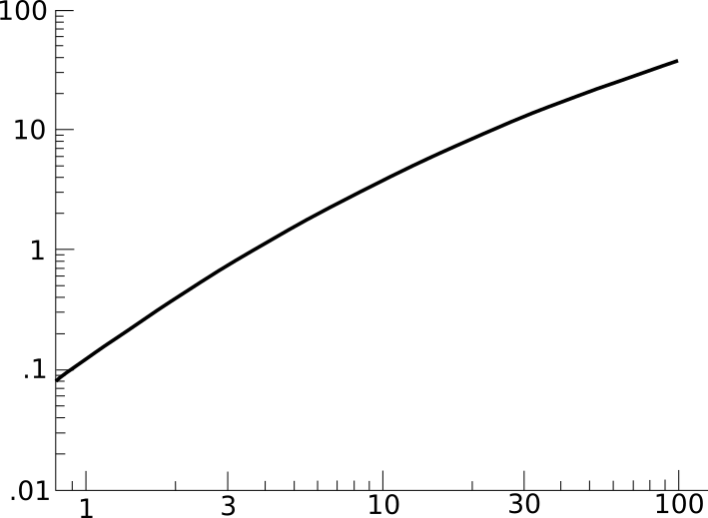
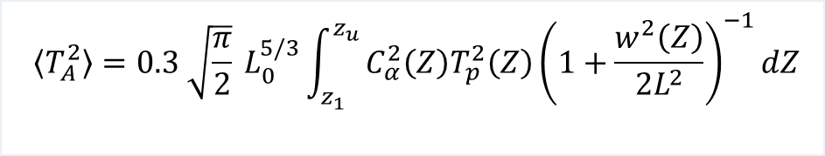
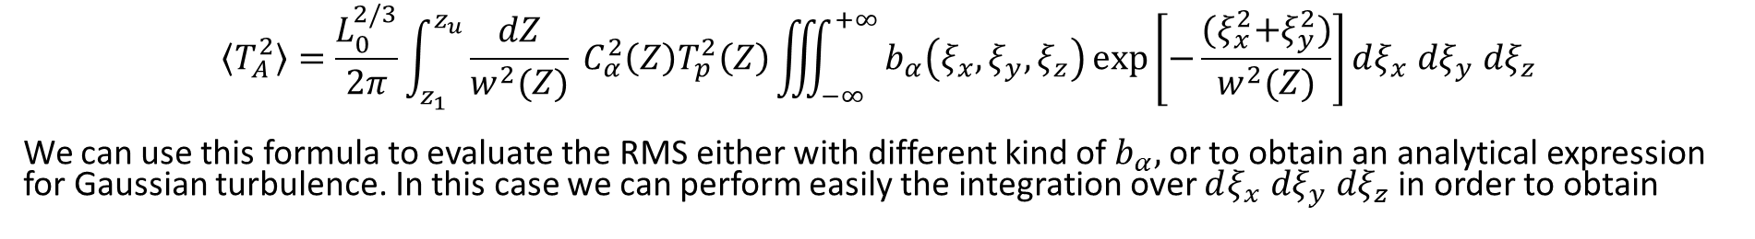
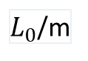
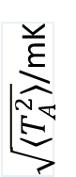
Antenna temperature RMS evaluation
$$〈T_{A}^{2}〉=\frac{L_{0}^{2/3}}{2π}\int_{z_{1}}^{z_{u}}{\frac{dZ}{w^{2}(Z)} C_{α}^{2}\left(Z\right)T_{p}^{2}\left(Z\right)\iiint_{−∞}^{+∞}{b_{α}\left(ξ_{x}, ξ_{y}, ξ_{z}\right)\exp{{\left[−\frac{{(ξ}_{x}^{2}+ξ_{y}^{2})}{w^{2}(Z)}\right]dξ_{x} dξ_{y} dξ}_{z}} }}$$
We can use this formula to evaluate the RMS either with different kind of $b_{α},$or to obtain an analytical expression for Gaussian turbulence. In this case we can perform easily the integration over $dξ_{x} dξ_{y} dξ_{z}$ in order to obtain
$$〈T_{A}^{2}〉=0.3 \sqrt{\frac{π}{2}} L_{0}^{5/3}{\int_{z_{1}}^{z_{u}}{C_{α}^{2}\left(Z\right)T_{p}^{2}\left(Z\right)\left(1+\frac{w^{2}\left(Z\right)}{2L^{2}}\right)}}^{−1}dZ$$
$\sqrt{〈T_{A}^{2}〉}$/mK
$L_{0}$/m

Slide 19
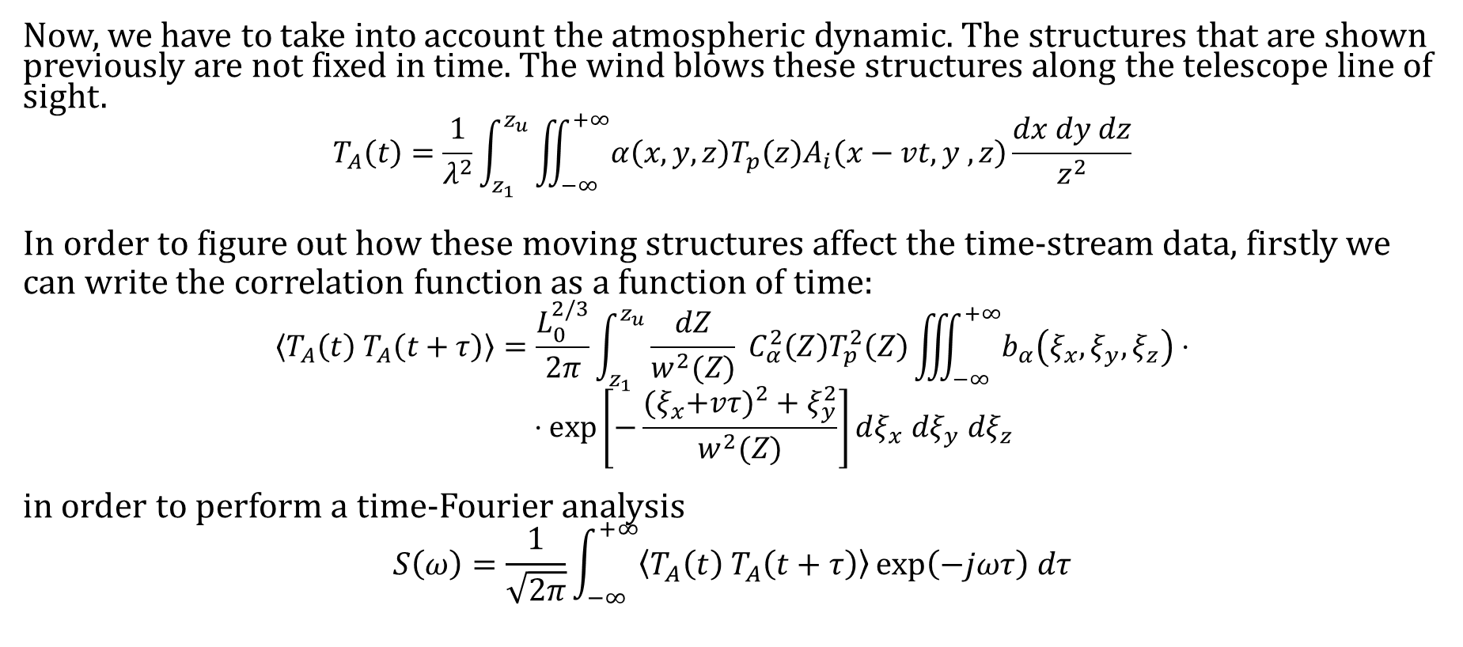
Temporal fluctuations in antenna temperature
Now, we have to take into account the atmospheric dynamic. The structures that are shown previously are not fixed in time. The wind blows these structures along the telescope line of sight.
$$T_{A}\left(t\right)=\frac{1}{λ^{2}}\int_{z_{1}}^{z_{u}}{\iint_{−∞}^{+∞}{α\left(x,y,z\right)T_{p}\left(z\right)A_{i}\left(x−vt, y ,z\right)}}\frac{dx dy dz}{z^{2}}$$
In order to figure out how these moving structures affect the time-stream data, firstly we can write the correlation function as a function of time: $$〈T_{A}\left(t\right) T_{A}\left(t+τ\right)〉=\frac{L_{0}^{2/3}}{2π}\int_{z_{1}}^{z_{u}}{\frac{dZ}{w^{2}(Z)} C_{α}^{2}\left(Z\right)T_{p}^{2}\left(Z\right)\iiint_{−∞}^{+∞}{b_{α}\left(ξ_{x}, ξ_{y}, ξ_{z}\right)}⋅} \\ ⋅\exp\left[−\frac{{(ξ}_{x}+v{τ)}^{2}+ξ_{y}^{2}}{w^{2}(Z)}\right]dξ_{x} dξ_{y} dξ_{z}$$
in order to perform a time-Fourier analysis
$$S\left(ω\right)=\frac{1}{\sqrt{2π}}\int_{−∞}^{+∞}{〈T_{A}\left(t\right) T_{A}\left(t+τ\right)〉\exp\left(−jωτ\right) dτ}$$

Slide 20
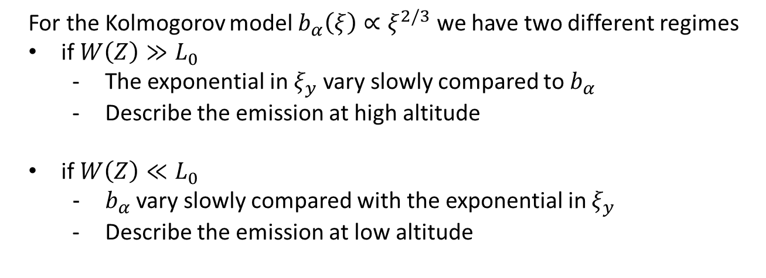
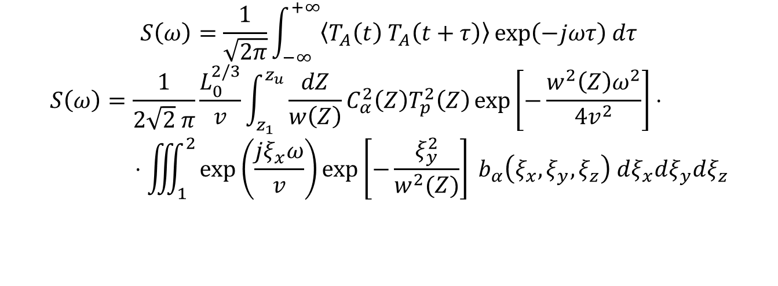
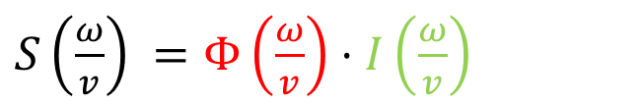
Temporal fluctuations in antenna temperature
$$S\left(ω\right)=\frac{1}{\sqrt{2π}}\int_{−∞}^{+∞}{〈T_{A}\left(t\right) T_{A}\left(t+τ\right)〉\exp\left(−jωτ\right) dτ}$$
$$S\left(ω\right)=\frac{1}{2\sqrt{2} π}\frac{L_{0}^{2/3}}{v}\int_{z_{1}}^{z_{u}}{\frac{dZ}{w\left(Z\right)}}C_{α}^{2}\left(Z\right)T_{p}^{2}\left(Z\right)\exp\left[−\frac{w^{2}\left(Z\right)ω^{2}}{4v^{2}}\right]⋅ \\ ⋅\iiint_{1}^{2}{\exp\left(\frac{jξ_{x}ω}{v}\right)\exp\left[−\frac{ξ_{y}^{2}}{w^{2}(Z)}\right] b_{α}\left(ξ_{x}, ξ_{y},ξ_{z}\right) dξ_{x}dξ_{y}dξ_{z}}$$
$S\left(\frac{ω}{v}\right) =Φ\left(\frac{ω}{v}\right)⋅I\left(\frac{ω}{v}\right)$
Temporal power spectrum due to motion of the atmosphere
Instrumental filter on the temporal power spectrum
For the Kolmogorov model $b_{α}\left(ξ\right)∝ξ^{2/3}$ we have two different regimes
if $W\left(Z\right)≫L_{0}$
The exponential in $ξ_{y}$ vary slowly compared to $b_{α}$
Describe the emission at high altitude
if $W\left(Z\right)≪L_{0}$
$b_{α}$vary slowly compared with the exponential in $ξ_{y}$
Describe the emission at low altitude

Slide 21
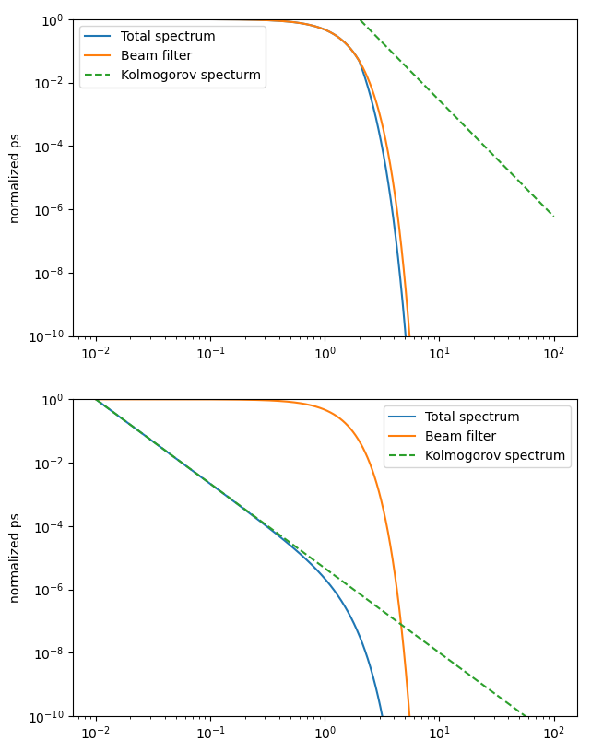
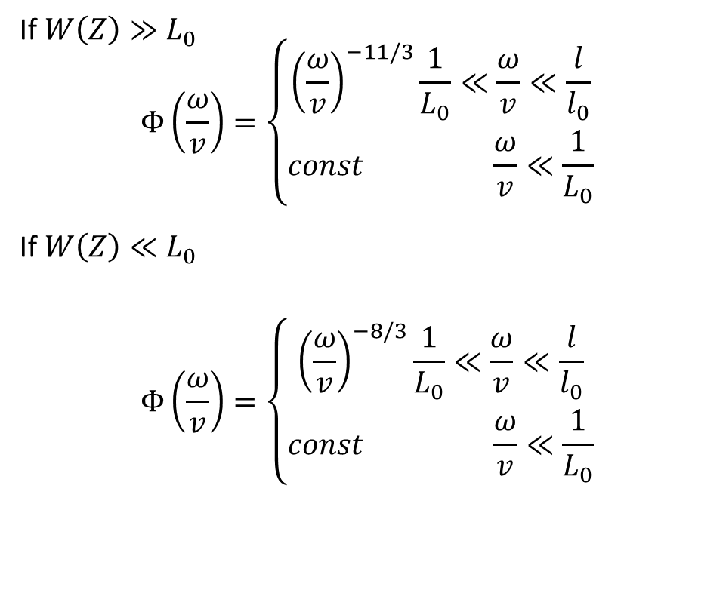
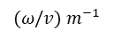
The two-slope model
If $W\left(Z\right)≫L_{0}$
$$Φ\left(\frac{ω}{v}\right)=\left\{\begin{matrix}{\left(\frac{ω}{v}\right)}^{−11/3}\frac{1}{L_{0}}≪\frac{ω}{v}≪\frac{l}{l_{0}} \\ const \frac{ω}{v}≪\frac{1}{L_{0}}\end{matrix}\right.$$
If $W\left(Z\right)≪L_{0}$
$$Φ\left(\frac{ω}{v}\right)=\left\{\begin{matrix}{\left(\frac{ω}{v}\right)}^{−8/3}\frac{1}{L_{0}}≪\frac{ω}{v}≪\frac{l}{l_{0}} \\ const \frac{ω}{v}≪\frac{1}{L_{0}}\end{matrix}\right.$$
$(ω/v)$ $m^{−1}$

Slide 22
Summary
Ongoing great efforts to improve the simulations introducing more realistic representations of the atmosphere.
Significant HPC resources
Code developing optimized for these clusters (mostly based on template-matching techniques)
Exploiting the great advantage of the GPU for this kind of problems
For the polarization signal we can adopt also some hardware solution in order to improve the capability to get rid of the atmospheric noise
HWP
Polarization modulator

Slide 23
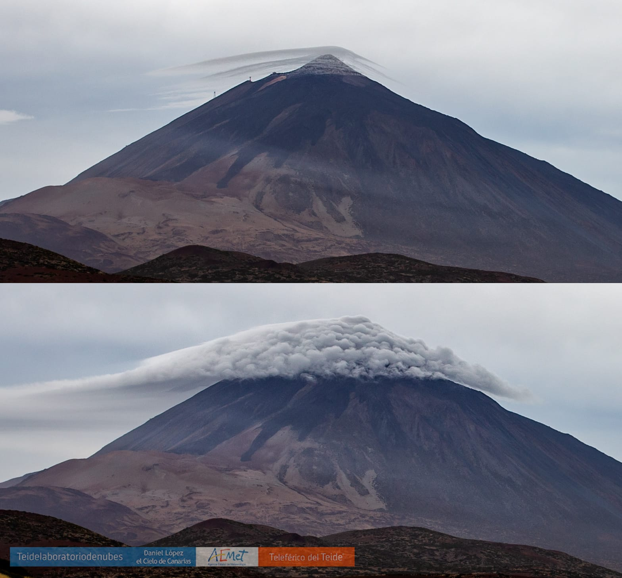
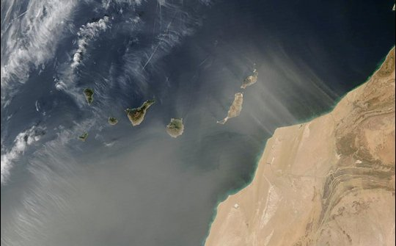
Saharian dust blows from the wind shear
Brunt–Väisälä waves cover the Pico del Teide mountain

Slide 24
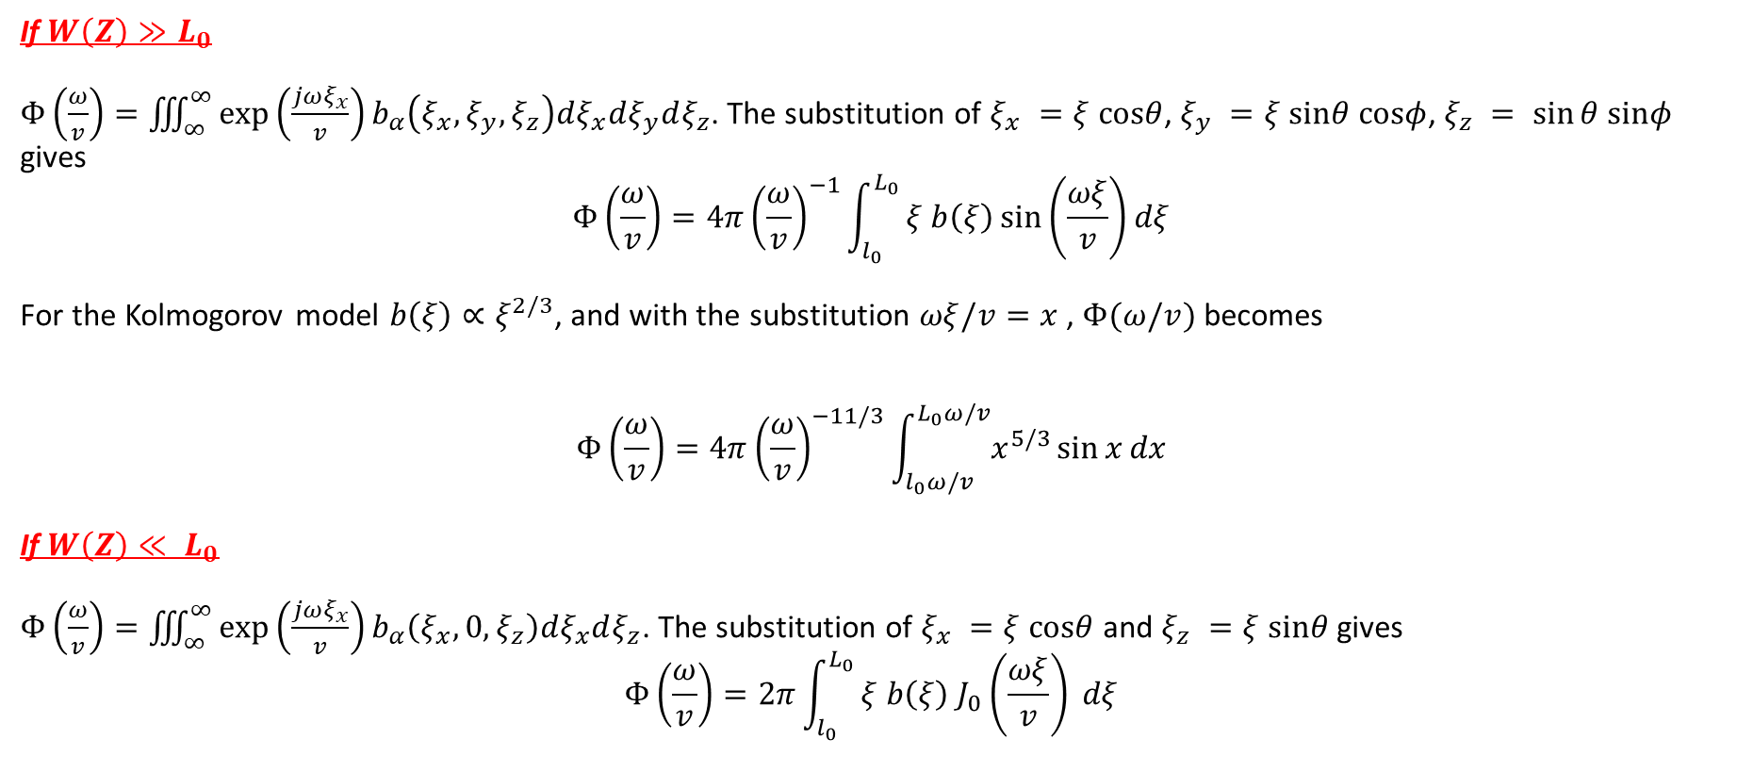
Kolmogorov contribute to the temporal power spectrum
If $W\left(Z\right)≫L_{0}$
$Φ\left(\frac{ω}{v}\right)=\iiint_{∞}^{∞}{\exp\left(\frac{jωξ_{x}}{v}\right)b_{α}\left(ξ_{x}, ξ_{y},ξ_{z}\right)dξ_{x}dξ_{y}dξ_{z}}$. The substitution of $ξ_{x} =ξ cosθ$, $ξ_{y} =ξ sinθ cosφ$, $ξ_{z} = sin⁡θ sinφ$ gives
$$Φ\left(\frac{ω}{v}\right)=4π{\left(\frac{ω}{v}\right)}^{−1}\int_{l_{0}}^{L_{0}}{ξ b\left(ξ\right)\sin\left(\frac{ωξ}{v}\right)dξ}$$
For the Kolmogorov model $b\left(ξ\right)∝ξ^{2/3}$, and with the substitution $ωξ/v=x$ , $Φ(ω/v)$ becomes
$$Φ\left(\frac{ω}{v}\right)=4π{\left(\frac{ω}{v}\right)}^{−11/3}\int_{l_{0}ω/v}^{L_{0}ω/v}{x^{5/3}\sin{x}dx}$$
If $W\left(Z\right)≪ L_{0}$
$Φ\left(\frac{ω}{v}\right)=\iiint_{∞}^{∞}{\exp\left(\frac{jωξ_{x}}{v}\right)b_{α}\left(ξ_{x}, 0,ξ_{z}\right)dξ_{x}dξ_{z}}$. The substitution of $ξ_{x} =ξ cosθ$ and $ξ_{z} =ξ sinθ$ gives
$$Φ\left(\frac{ω}{v}\right)=2π\int_{l_{0}}^{L_{0}}{ξ b\left(ξ\right) J_{0}\left(\frac{ωξ}{v}\right) dξ}$$

